Slide 1

RetailIQ: E-Commerce Customer & Sales Analytics
DATA SCIENCE (24AD3107) | PROJECT REVIEW–1
 | Under the Guidance of Ms. B Pratusha Assisstant Professor Department of Computer Science and Engineering KLH CSE, Bowrampet Campus
Team Members: Dhanya Sri — 2420030023 Tanvi Bandaru — 2420030507 Sarvani Topella — 2420030367

Slide 2
Outline of Project Work
Focus
Introduction
Literature Survey
Challenges
Research Objectives
Conclusion & Future Work
References
Publications Details
2

Slide 3
Problem Statement
E-commerce stores collect lots of order data, but it can be hard to turn it into clear business decisions.
Customer patterns
Identify frequent and high-value customers
Understand customers who may stop buying
Product performance
Identify top-performing products
Compare sales across categories
Product combinations
Find products commonly purchased together
Identify useful product associations
Sales planning
Analyze historical sales trends
Support future sales planning
3

Slide 4
Objectives
1. Prepare the data
Clean missing, duplicate and inconsistent records.
2. Explore sales
Analyze sales trends across time, regions and categories.
3. Group customers
Use RFM to segment customers by buying behavior.
4. Find product links
Identify products that are frequently purchased together.
5. Explore forecasting
Use past sales to build and test a simple forecast.

Slide 5
Literature Survey
Area | Method | How it helps our project | Point to consider
Customer analytics | RFM segmentation | Groups customers by recency, frequency and spend. | Segment cut-offs depend on the data. | Depends on chosen RFM cut-offs.
Market basket | Apriori / FP-Growth | Finds products often appearing in the same order. | Results depend on basket setup and thresholds. | Depends on basket definition and thresholds.
Sales forecasting | Regression / time series | Uses past sales to estimate future trends. | Test on later dates, not training data. | Needs testing on unseen dates.
5

Slide 6
Problem Gap Identification
Analyses done separately →
Combine data cleaning, EDA, RFM, basket analysis and forecasting
Customer data viewed alone →
Connect customer groups with product and sales patterns
Product sales without combinations →
Combine product performance with co-purchased items
Findings difficult to use →
Present insights through clear charts and summaries

Slide 7
Innovation, Creativity, and Novelty
Connected steps
Connect raw data to final insights
Follow a clear analytical workflow
Combined view
Analyze customers, products and sales together
Connect different business perspectives
Useful takeaways
Support customer retention analysis
Support product focus and sales planning
Easy to understand
Use simple visualizations
Present results through a dashboard

Slide 8
Project Design
RetailIQ is designed as an integrated analytics workflow that converts e-commerce order data into useful customer, product, and sales insights.
Main Components:
Data Preparation – clean and organize raw records.
Exploratory Data Analysis – understand sales and customer patterns.
RFM Analysis – group customers based on buying behavior.
Market Basket Analysis – identify products frequently purchased together.
Sales Forecasting – explore future sales trends using historical data.
Visualization & Dashboard – present findings through clear charts and summaries.

Slide 9
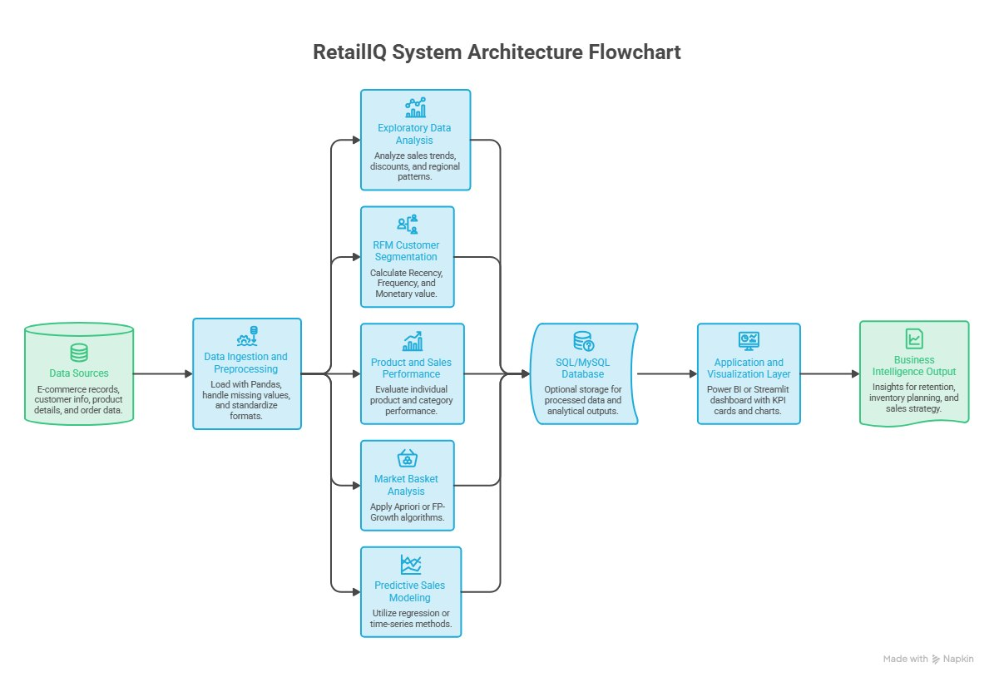
Architecture

Slide 10
Methodology
Data Preparation
Clean missing, duplicate and inconsistent records.
Prepare the dataset for analysis.
Exploratory Data Analysis
Analyze sales across time, regions and categories.
Identify customer and product patterns.
Customer & Product Analysis
Use RFM to segment customers by buying behavior.
Use Apriori / FP-Growth to find products frequently purchased together.
Sales Forecasting
Use historical sales data to build and test a simple forecast.
Test the model on later/unseen dates.

Slide 11
Technical Soundness of the Project
Data Quality
Handle missing, duplicate and inconsistent records.
Use cleaned data for reliable analysis.
Analytical Methods
RFM for customer segmentation.
Apriori / FP-Growth for product associations.
Regression / Time Series for sales forecasting.
Validation
Test forecasting using later/unseen dates.
Consider appropriate thresholds for RFM and basket analysis.

Slide 12
Technical Soundness of the Project
Area | Technology
Programming | Python
Data Processing | Pandas, NumPy
Visualization | Matplotlib / Seaborn
Machine Learning | Scikit-learn
Development Environment | Jupyter Notebook
Final Presentation | Dashboard & Reports

Slide 13
Feasibility and Project Plan
Tools: Python, Pandas, NumPy, Matplotlib/Seaborn, scikit-learn and Jupyter Notebook.
Planned phases and timeline
PHASE 1 2 3 4 5 6 7 8 9 10
Understand data
Clean & explore
Customer + product analysis
Market basket analysis
Sales forecasting
Dashboard & report
Expected outputs: cleaned dataset • customer groups • product combinations • sales forecast charts/dashboard

Slide 14
Conclusion & Future Work
Conclusion: RetailIQ provides an integrated approach to e-commerce analytics by connecting:
Data Cleaning + EDA + RFM + Market Basket Analysis + Forecasting
The project aims to transform raw e-commerce data into understandable customer, product, and sales insights.
Future Work
Improve customer segmentation.
Experiment with forecasting approaches.
Improve dashboard visualization.
Extend analysis with additional e-commerce data.
Provide more actionable business summaries.

